Slide 1


PCD : PRINCIPALS OF COMPILER DESIGN
Introduction to Compilers & Phases of Compiler
Department of IT
Unit no : 1 Introduction to Compilers &
Phases of Compiler
FACULTY:
MS.G.VIDYASREE

Slide 2
Outline :
Department of IT
Unit no : 1 Introduction to Compilers
Translator
Compiler, Interpreter, Assembler Cousins of Compiler
Phases of Compiler Grouping of Phases Types of Compiler
Compiler construction tools Pass and Phase

Slide 3


What is Compiler?
Why we need it?
Basic Terminology

Slide 4



Translator

Slide 5
Translator :
A translator is a program which takes one program (written in one language) as input and converts it into another language (Target language).
Input Language is Source Language and Output Language is Target Language.
Translator
There are Three types of Translator :
Compiler
Interpreter
Assembler
🞄 It also detects and reports error during translation.

Slide 6
Compiler :
🞄 Compiler is a program that reads a program written in one language that means source language and translates it into equivalent program into another language that is target language.
🞄 Compiler is a program which translates higher level language into functionally equivalent lower level language.
🞄 It also detects and reports error.
Compiler
Source
Program
Compiler
Target
Program
Error

Slide 7
Operations of Compilers
These are some operations that are done by the compiler.
Breaks source programs into smaller parts.
Enables the creation of symbol tables and intermediate representations.
Helps in Error Detection.
Saves all codes and variables.
Analyses the full program and translates it.
Convert source code to machine code.
Compiler

Slide 8
Interpreter :
🞄 Interpreter is a translator which is used to convert programs in high-level language to low-level language.
🞄 Interpreter translates line by line and reports the error once it encountered during the translation process.
Interpreter
Source Program
Target Program
Interpreter
Error

Slide 9
Assembler :
🞄 An assembler
is a translator used to
translate
assembly language to machine language.
🞄 An assembler translates a low-level language, an assembly language to an even lower-level language, which is the machine code. The machine code can be directly understood by the CPU.
Assembler
Source Program
Assembler
Target Program
Error

Slide 10
Compiler Vs Interpreter
Compiler | Interpreter
It takes whole program as input | It takes single instruction as input
It generates intermediate object code | It does not generate any intermediate object code
Memory requirement is more due to creation of object code. | Memory requirement is less (memory efficient) as it does not create intermediate object code.
It takes large amount of time to analyze the source code but overall execution is comparatively faster. | It takes less amount of time to analyze the source code but overall execution is slower.
Compilation is done before execution. | Compilation and execution take place simultaneously.
Display all errors after entire program is checked. | Display errors of each line one by one.
Ex : C , C ++ | Ex : BASIC , Python

Slide 11
Compiler Vs Assembler
Compiler | Assembler
Input for compiler is Pre processed Source code. | Input for Assembler is Assembly language code.
It generates assembly language code or directly the executable code. | It generates the relocatable machine code.
There are 6 Phases of compiler | It makes Two passes over given input.
Ex : C , C ++ | Ex : 8085 , 8086

Slide 12
Language Processing System
/ Translation Processor
HLL
Pre Processor
Pure HLL
Compiler
Assembly Language
/ Context of Compiler
/Cousins of Compiler
Assembler
Relocatable Machine code
Linker & Loader
Library ,
Relocatable object files
Absolute Machine code

Slide 13
Language Processing System
/ Translation Processor
🞄 There are three cousins of Compiler
Preprocessor
Assembler
Linker and Loader
/ Context of Compiler
/Cousins of Compiler

Slide 14
Language Processing System
/ Translation Processor
Preprocessor
The preprocessor processes the source code before compilation begins.
It performs the following tasks:
File inclusion (#include)
Macro expansion (#define)
Removal of comments
Conditional compilation
Example: If the program contains #include <stdio.h>, the preprocessor replaces this directive with the actual contents of the stdio.h file in the output.
🞄
/ Context of Compiler
/Cousins of Compiler

Slide 15
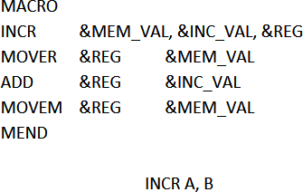
Language Processing System
/ Translation Processor
1) Preprocessor
🞄 Macro processor deal with two kinds of statement
→Macro Definition
→Macro Use
/ Context of Compiler
/Cousins of Compiler
Formal Parameters
add(5, 3)
a = 5
b = 3
Actual Parameters

Slide 16
2) Assembler
Language Processing System
/ Translation Processor
/ Context of
Compiler
/Cousins of Compiler
🞄 An assembler is a
translator used to translate
assembly language to machine language.
🞄 An assembler translates a low-level language, an assembly language to an even lower-level language, which is the machine code. The machine code can be directly understood by the CPU.
Source Program
Assembler
Target Program
Error

Slide 17
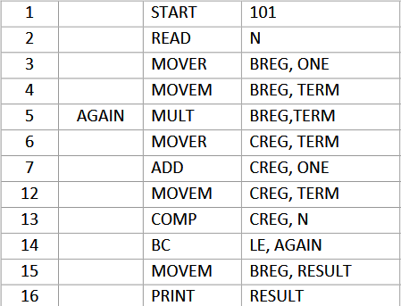
2) Assembler
🞄 Assembly code is mnemonic version of machine code, in which names are used instead of binary codes for operation and names are also given to memory address.
Language Processing System
/ Translation Processor
/ Context of
Compiler
/Cousins of Compiler

Slide 18
3) Linker and Loader
🞄 A program called loader performs the two functions of loading and link editing
🞄 The process of loading consist of taking relocatable machine code , altering the relocatable address and placing the altered instructions and data in memory at the proper location.
🞄 Linker allows us to make a single program from several
files of relocatable machine code.
🞄 Types of Linking : Static and Dynamic
🞄 Types of Loader : Compile and Go loader, Absolute
Loader, Relocating Loader.
Language Processing System
/ Translation Processor
/ Context of
Compiler
/Cousins of Compiler

Slide 19
Lexical Analyzer
Analysis Phase
Syntax Analyzer
Semantic
Analyzer
Phases of Compiler
Symbol Table Manager
Error handler
Intermediate
Code Generator
Code Optimizer
Synthesis Phase
Code Generator

Slide 20
🞄 There are two parts of Compilation Process :
Analysis Phase
It breaks up source program into small pieces and create an intermediate representation of source program.
Synthesis Phase
It constructs the desired target program from intermediate representation.
Phases of Compiler
/ Analysis –
Synthesis Model of Compilation

Slide 21


1)Analysis Phase:
Consist of Three SubPhases :
🞄 Lexical analysis
🞄 Syntax analysis
🞄 Semantic analysis
Phases of Compiler
/ Analysis –
Synthesis Model of Compilation
2) Synthesis Phase :
Consist of Three Sub Phases :
🞄 Intermediate Code generation
🞄 Code Optimization
🞄 Code Generation

Slide 22
Phases of Compiler
Lexical Analyzer

Slide 23
1) Lexical Analysis
🞄 It is also called Linear analysis or scanning.
🞄 In this phase, input character from source code is read from left to right and then break into stream of units. These units are called tokens.
🞄 Sequence of characters having a collective meaning is called Token.
🞄 Tokens can be categorized into identifiers, constants, literals, keywords, operators, delimeters etc.
🞄 So, Token is the smallest meaningful entities of program are produced as output.
Phases of Compiler
/ Analysis –
Synthesis Model of Compilation

Slide 24
1) Lexical Analysis
Example : position = initial + rate * 60
id1 = id2 + id3 * 60
Phases of Compiler
/ Analysis –
Synthesis Model of Compilation
Position | Identifier 1
= | Equal to operator
Initial | Identifier 2
+ | Addition Operator
Rate | Identifier 3
* | Multiplication Operator
60 | Constant

Slide 25
Phases of Compiler
Lexical Analyzer
Syntax Analyzer

Slide 26
2) Syntax Analysis
🞄 It is also called Hierarchical analysis or Parsing.
🞄 It determines if the sentence formed from the words are syntactically (grammatically) correct.
🞄 It creates syntax tree from generated tokens if the code is error free.
🞄 Syntax tree consist operators as internal node and operands as leaf node.
🞄 This phase check each and every line and try to detect errors if it is grammatically (syntax wise) not correct.
Phases of Compiler
/ Analysis –
Synthesis Model of Compilation

Slide 27
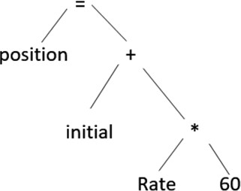
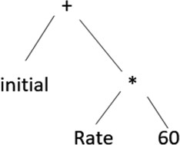

Phases of Compiler
/ Analysis –
2) Syntax Analysis position = initial + rate * 60 Three Operators : = + * position = initial + rate * 60 position = initial + rate * 60
position = initial + rate * 60
Synthesis Model of Compilation

Slide 28
Phases of Compiler
Lexical Analyzer
Syntax Analyzer
Semantic Analyzer

Slide 29
3) Semantic Analysis
🞄 It determines meaning of string
🞄 In semantic analysis various operations are performed like
🞄 Performing check ; whether operator have compatible arguments or not (type checking) , matching of parenthesis, scope of operation etc.
🞄 Ensuring that components of a program fits together meaningfully.
Semantic analysis inserts a conversion from integer to real
Phases of Compiler
/ Analysis –
Synthesis Model of Compilation

Slide 30
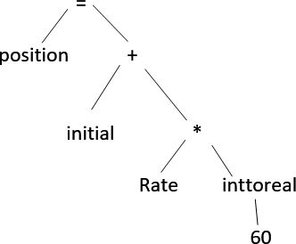
3) Semantic Analysis
position = initial + rate * 60
Phases of Compiler
/ Analysis –
Synthesis Model of Compilation

Slide 31
Phases of Compiler
Lexical Analyzer
Syntax Analyzer
Semantic Analyzer
Intermediate
Code Generator

Slide 32
4) Intermediate Code Generator
🞄 Intermediate code generation should have two properties :
it should be easy to produce, easy to translate.
🞄 Intermediate code is called “Three Address Code”.
🞄 It is called three address code as it maximum consist
three operands.
Phases of Compiler
/ Analysis –
Synthesis Model of Compilation

Slide 33
4) Intermediate Code Generator
Example : position = initial + rate * 60 t1 = inttoreal(60)
t2 = rate * t1 t3 = initial + t2 position = t3
Phases of Compiler
/ Analysis –
Synthesis Model of Compilation

Slide 34
Phases of Compiler
Lexical Analyzer
Syntax Analyzer
Semantic Analyzer
Intermediate
Code Generator
Code Optimizer

Slide 35
5) Code Optimization
🞄 This phase improves the intermediate code, in such a way that a machine code can be produced, which occupies less memory space and less execution time without changing the functionality or correctness of program.
🞄 Example :
t1 = rate * 60.00
position = initial + t1
Phases of Compiler
/ Analysis –
Synthesis Model of Compilation

Slide 36
Lexical Analyzer
Syntax Analyzer
Semantic
Analyzer
Phases of Compiler
Intermediate
Code Generator
Code Optimizer
Code Generator

Slide 37
6) Code Generation
🞄 In Code generation phase the target code gets generated.
Phases of Compiler
/ Analysis –
Synthesis Model of Compilation
🞄 In this phase intermediate (optimized) code is
translated into a sequence of machine instructions that
perform the same operation.
🞄 Example :
MOVF id3,R1 MULF #60.00, R1 MOVF id2, R2 ADDF R2, R1 MOVF R1, id1
position = initial + rate * 60 id 1 id2 id3
R1 = id3 (rate) R1 = 60.00 * R1
R2 = id2 (initial) R1 = R2 + R1
id1(position) = R1

Slide 38
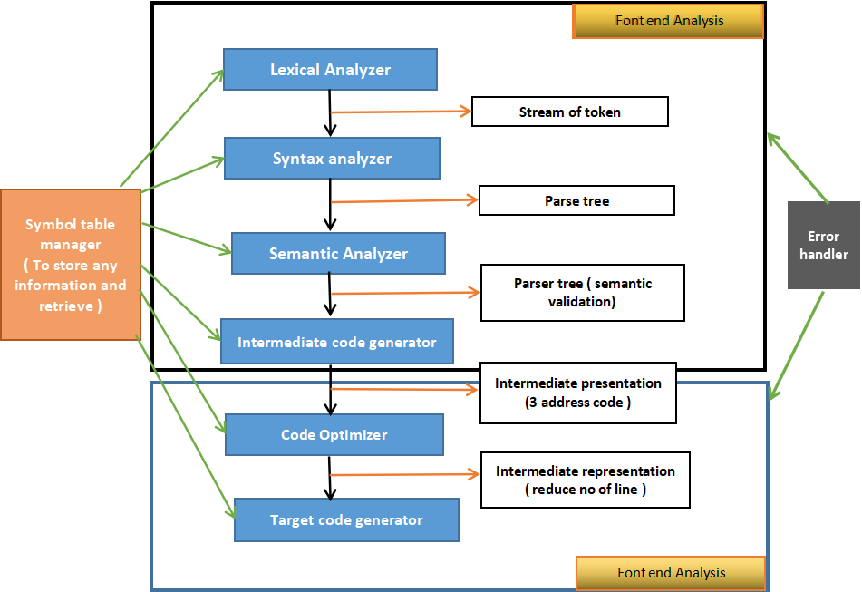
Phases of Compiler

Slide 39
Symbol Table :
🞄 A symbol table is data structure used by language translators.
🞄 In order to keep track of identifiers used by program, compiler maintains the record of the same with their various attributes.
🞄 Symbol table stores information for different entities : Identifier, Function, Procedure, Constant , Label Name, Compiler generated temporaries etc.
Phases of Compiler
/ Analysis –
Synthesis Model of Compilation

Slide 40
Error Detection and Recovery :
🞄 Each phase can encounter errors, However after detecting an error a phase must some how deal with
that error. So that Compilation can proceed, allowing further errors in the source program to be detected.
🞄 Lexical Analyzer can detect errors where the character remaining in the input do not form any token of the language.
🞄 Errors where the token stream violates the structure rule (syntax) of the language are determined by syntax analysis phase.
🞄 During Semantic analysis, the compiler tries to detect constructs that have the right syntactic structure but no meaning to the operation involved.
Phases of Compiler
/ Analysis –
Synthesis Model of Compilation

Slide 41
a=b+c*60
Intermediate code generator
Lexical analyzer
t1:= inttofloat (60)
t2:= id3 * t1 t3:= id2 + t2 id1:= t3
Id1=id2+id3*60
Phases of Compiler
/ Analysis –
Synthesis Model of Compilation
Syntax analyzer
=
Code optimizer
+
id1
id2
*
t1:= id3 * 60.0 id1:= id2 + t1
id3 60
Semantic analyzer
Code generator
=
+
id1
id2
*
MOVEF id3, R2 MULF #60.0,R2 MOVF id2, R1 ADDF R2,R1 MOVF R1,id1
id3 Int to float
60

Slide 42
Example :
What will be the output of each phase for the following statement?
Statement : x = a + b * c
Practice Time

Slide 43
Front End
Back End
Grouping of Phases
Dependent : Source Language
Dependent : Target Machine
Independent : Source Language
Independent : Target Machine

Slide 44
🞄 Front end consist of those phase, that depends
Front End:
preliminary on the source language & are independent of the target machine.
🞄 It includes Lexical analysis, Syntax analysis, Semantic analysis, Intermediate code generation and Creation of Symbol table.
🞄 A certain amount of code optimization can be done by the front end as well
🞄 The front end also includes error handling that goes along with each of these phases.
Grouping of Phases

Slide 45
🞄 Back includes those portion of compiler that depend on the target machine and do not depend on source language.
Back End:
🞄 Back end includes code optimization and code
Grouping of Phases
generation with necessary error handling and
symbol table operation.
It has become fairly routine to take front end of a compiler & redo its back end to produce a compiler for the same source language on a different machine.

Slide 46
🞄 One Complete scan of Source program is called Pass.
🞄 Difficulty in single pass :
→ Forward Reference : A forward reference means variable or label is referenced before its declared.
🞄 It leads to Multi-Pass model.
Pass – 1 : Perform analysis of source program and note relevant information
Pass – 2 : Generate target code using information noted in pass-1.
Pass of Compiler
START 100
READ A
MOVER AREG , A
........
........ BC STOP
(AD,01) (C,200)
(IS,09) (S,01)
..............
...............
...............
............... (IS , 00)
(DL,02) (C,1)
LOOP
GT , LOOP
A
DS
.......
1

Slide 47
Pass Vs Phase
Pass | Phase
Various phases are logically grouped together to form a pass. | The process of compilation is carried out in various step is called Phase.
Require Less Memory | Require More Memory
Execution is faster | Execution is slower
Less memory operation(read/write) to be performed | More memory operations to be performed
2 Passes of Compiler | 6 Phases of Compiler

Slide 48
Types of Compiler
Native Compiler
Cross Compiler
Source to Source Compiler
Just in Time Compiler
Incremental Compiler
Parallelizing Compiler

Slide 49
🞄 The compiler used to Compile a source code for
Native Compiler :
same type of platform only.
🞄 The output generated by this type of compiler can only be run on the same type of computer system and OS that the compiler itself runs on.
Cross Compiler :
🞄 The compiler used to compile a source code for
different kinds platform.
🞄 A Cross compiler is a compiler capable of creating executable code for a platform other than one on which compiler is running.
Types of Compiler

Slide 50
🞄 The compiler that takes high-level language code as input and outputs source code of another high- level language only.
Source to Source Compiler :
🞄 Unlike other compilers which convert high level language into low level machine language, it can take up a code written in Pascal and can transform it into C-conversion of one high level language into another high level language having same type of abstraction .
🞄 Thus, it is also known as transpiler .
Types of Compiler

Slide 51
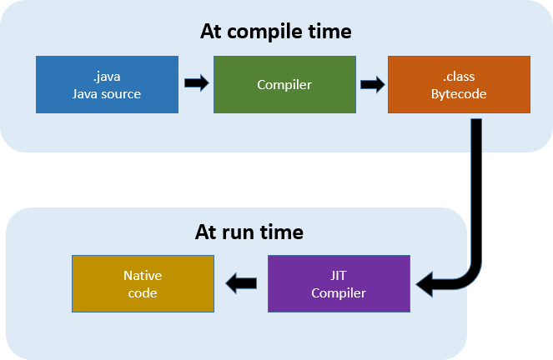
🞄 The compiler which converts a code into machine
Just in Time Compiler :
code after the program starts execution.
🞄 Convert .java file into .class file.
Types of Compiler

Slide 52
🞄 The compiler which compiles only the changed lines
Incremental Compiler :
from the source code and update the object code.
Parallelizing Compiler :
🞄 A Compiler which is specially designed to run in
Types of Compiler
parallel computer architecture is known as
parallelizing compiler.
int a=0; int b=1;
printf("Enter Input");
Scanf();
if(a==10) printf();

Slide 53
1) Scanner Generators
Compiler Construction Tools :
Parser Generators
Syntax – directed translation engines
Automatic Code Generators
Data Flow Engine
Compiler Construction Tools

Slide 54
Parser generators: A parser generator takes a grammar as input and automatically generates source code which can parse streams of characters with the help of a grammar
Scanner generators: This tool takes regular expressions as input. For example LEX for Unix Operating System.
Syntax-directed translation engines: These software tools offer an intermediate code by using the parse tree. It has a goal of associating one or more translations with each node of the parse tree.
Compiler Construction Tools
Automatic code generators: Takes intermediate code and
converts them into Machine Language
Data-flow engines: This tool is helpful for code optimization. Here, information is supplied by user and intermediate code is compared to analyze any relation. It is also known as data-flow analysis. It helps you to find out how values are transmitted from one part of the program to another part.

Slide 55
🞄 It must generate correct machine code.
🞄 Compiler itself must be bug free.
🞄 Generated machine code must run fast (Execution speed).
🞄 Compilation time must be less.
🞄 Compilation must be portable.
🞄 It must be print good diagnostics and Error message.
🞄 Generated code must work well with existing debugger.
🞄 It must have consistent and Predictable optimization.
Qualities of Compiler

Slide 56
1) Develop Analysis – Synthesis model of Compiler for a = b + c * 20. Write down explanation and output for each phase of compiler.
Difference between Compiler and Interpreter.
Explain Cousins of compiler.
Give the name of Front End and Back End with explanation, and take one example to show the output of the every phase.
List out different types of compiler and explain any two of them in detail.
Explain the Language processor in detail.
Define the term: Compiler, Interpreter, Assembler, Translator
Questions

Slide 57
Thanks

